Slide 1
Analysis Techniques
Software Architecture
Lecture 14

Slide 2
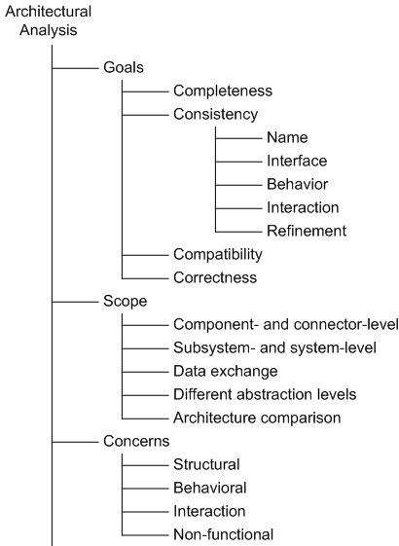
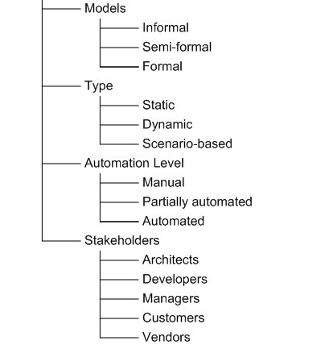
Architectural Analysis in a Nutshell
Software Architecture: Foundations, Theory, and Practice; Richard N. Taylor, Nenad Medvidovic, and Eric M. Dashofy; © 2008 John Wiley & Sons, Inc. Reprinted with permission.

Slide 3
Analysis Technique Categories
Inspection- and review-based
Model-based
Simulation-based

Slide 4
Architectural Inspections and Reviews
Architectural models studied by human stakeholders for specific properties
The stakeholders define analysis objective
Manual techniques
  Can be expensive
Useful in the case of informal architectural descriptions
Useful in establishing “soft” system properties
  E.g., scalability or adaptability
Able to consider multiple stakeholders’ objectives and multiple architectural properties

Slide 5
Inspections and Reviews in a Nutshell
Analysis Goals – any
Analysis Scope – any
Analysis Concern – any, but particularly suited for non-functional properties
Architectural Models – any, but must be geared to stakeholder needs and analysis objectives
Analysis Types – mostly static and scenario-based
Automation Level – manual, human intensive
Stakeholders – any, except perhaps component vendors

Slide 6
Example – ATAM
Stands for architectural trade-off analysis method
Human-centric process for identifying risks early on in software design
Focuses specifically on four quality attributes (NFPs)
  Modifiability
  Security
  Performance
  Reliability
Reveals how well an architecture satisfies quality goals and how those goals trade-off

Slide 7
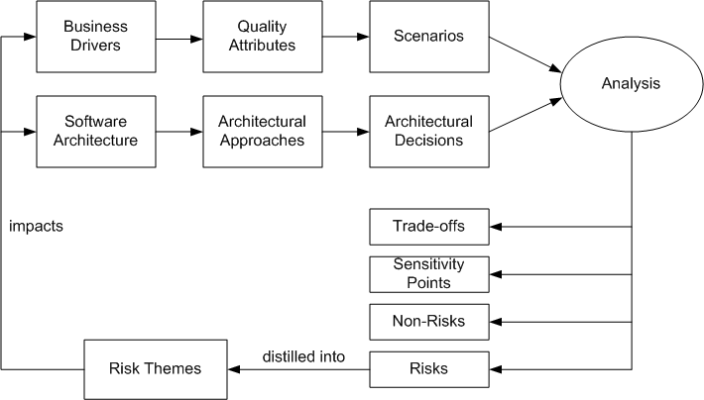
ATAM Process
Software Architecture: Foundations, Theory, and Practice; Richard N. Taylor, Nenad Medvidovic, and Eric M. Dashofy; © 2008 John Wiley & Sons, Inc. Reprinted with permission.

Slide 8
ATAM Business Drivers
The system’s critical functionality
Any technical, managerial, economic, or political constraints
The project’s business goals and context
The major stakeholders
The principal quality attribute (NFP) goals

Slide 9
ATAM Scenarios
Use-case scenarios
  Describe how the system is envisioned by the stakeholders to be used
Growth scenarios
  Describe planned and envisioned modifications to the architecture
Exploratory scenarios
  Try to establish the limits of architecture’s adaptability with respect to
    system’s functionality
    operational profiles
    underlying execution platforms
  Scenarios are prioritized based on importance to stakeholders

Slide 10
ATAM Architecture
Technical constraints
  Required hardware platforms, OS, middleware, programming languages, and OTS functionality
Any other systems with which the system must interact
Architectural approaches that have been used to meet the quality requirements
  Sets of architectural design decisions employed to solve a problem
  Typically architectural patterns and styles

Slide 11
ATAM Analysis
Key step in ATAM
Objective is to establish relationship between architectural approaches and quality attributes
For each architectural approach a set of analysis questions are formulated
  Targeted at the approach and quality attributes in question
System architects and ATAM evaluation team work together to answer these questions and identify
  Risks → these are distilled into risk themes
  Non-Risks
  Sensitivity points
  Trade-off points
Based on answers, further analysis may be performed

Slide 12
ATAM in a Nutshell
Goals | Completeness Consistency Compatibility Correctness`
Scope | Subsystem- and system-level Data exchange
Concern | Non-functional
Models | Informal Semi-formal
Type | Scenario-driven
Automation Level | Manual
Stakeholders | Architects Developers Managers Customers
Software Architecture: Foundations, Theory, and Practice; Richard N. Taylor, Nenad Medvidovic, and Eric M. Dashofy; © 2008 John Wiley & Sons, Inc. Reprinted with permission.

Slide 13
Model-Based Architectural Analysis
Analysis techniques that manipulate architectural description to discover architectural properties
Tool-driven, hence potentially less costly
Typically useful for establishing “hard” architectural properties only
  Unable to capture design intent and rationale
Usually focus on a single architectural aspect
  E.g., syntactic correctness, deadlock freedom, adherence to a style
Scalability may be an issue
Techniques typically used in tandem to provide more complete answers

Slide 14
Model-Based Analysis in a Nutshell
Analysis Goals – consistency, compatibility, internal correctness
Analysis Scope – any
Analysis Concern – structural, behavioral, interaction, and possibly non-functional properties
Architectural Models – semi-formal and formal
Analysis Types – static
Automation Level – partially and fully automated
Stakeholders – mostly architects and developers

Slide 15
Model-Based Analysis in ADLs
Wright – uses CSP to analyze for deadlocks
Aesop – ensures style-specific constraints
MetaH and UniCon – support schedulability analysis via NFPs such as component criticality and priority
ADL parsers and compilers – ensure syntactic and semantic correctness
  E.g., Rapide’s generation of executable architectural simulations
Architectural constraint enforcement
  E.g., Armani or UML’s OCL
Architectural refinement
  E.g., SADL and Rapide

Slide 16
ADLs’ Analysis Foci in a Nutshell
Goals | Consistency Compatibility Completeness (internal)
Scope | Component- and connector-level Subsystem- and system-level Data exchange Different abstraction levels Architecture comparison
Concern | Structural Behavioral Interaction Non-functional
Models | Semi-formal Formal
Type | Static
Automation Level | Partially automated Automated
Stakeholders | Architects Developers Managers Customers
Software Architecture: Foundations, Theory, and Practice; Richard N. Taylor, Nenad Medvidovic, and Eric M. Dashofy; © 2008 John Wiley & Sons, Inc. Reprinted with permission.

Slide 17
Architectural Reliability Analysis
Reliability is the probability that the system will perform its intended functionality under specified design limits, without failure
A failure is the occurrence of an incorrect output as a result of an input value that is received, with respect to the specification
An error is a mental mistake made by the designer or programmer
A fault or a defect is the manifestation of that error in the system
  An abnormal condition that may cause a reduction in, or loss of, the capability of a component to perform a required function
  A requirements, design, or implementation flaw or deviation from a desired or intended state

Slide 18
Reliability Metrics
Time to failure
Time to repair
Time between failures

Slide 19
Assessing Reliability at Architectural Level
Challenged by unknowns
  Operational profile
  Failure and recovery history
Challenged by uncertainties
  Multiple development scenarios
  Varying granularity of architectural models
  Different information sources about system usage
Architectural reliability values must be qualified by assumptions made to deal with the above uncertainties
Reliability modeling techniques are needed that deal effectively with uncertainties
  E.g., Hidden Markov Models (HMMs)

Slide 20
Architectural Reliability Analysis in a Nutshell
Goals | Consistency Compatibility Correctness
Scope | Component- and connector-level Subsystem- and system-level
Concern | Non-functional
Models | Formal
Type | Static Scenario-based
Automation Level | Partially automated
Stakeholders | Architects Managers Customers Vendors
Software Architecture: Foundations, Theory, and Practice; Richard N. Taylor, Nenad Medvidovic, and Eric M. Dashofy; © 2008 John Wiley & Sons, Inc. Reprinted with permission.

Slide 21
Simulation-Based Analysis
Requires producing an executable system model
Simulation need not exhibit identical behavior to system implementation
  Many low-level system parameters may be unavailable
It needs to be precise and not necessarily accurate
Some architectural models may not be amenable to simulation
  Typically require translation to a simulatable language

Slide 22
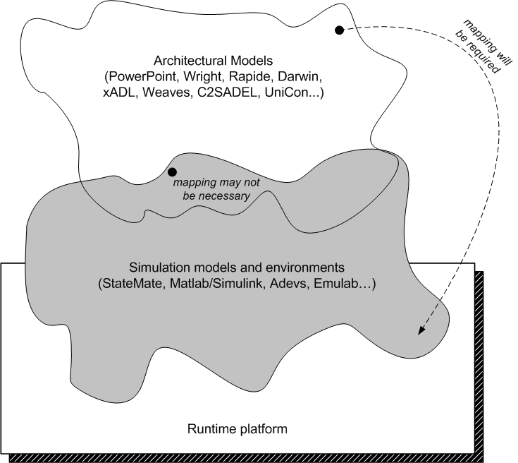
Architectural and Simulation Models
Software Architecture: Foundations, Theory, and Practice; Richard N. Taylor, Nenad Medvidovic, and Eric M. Dashofy; © 2008 John Wiley & Sons, Inc. Reprinted with permission.

Slide 23
Simulation-Based Analysis in a Nutshell
Analysis Goals – any
Analysis Scope – any
Analysis Concern –behavioral, interaction, and non-functional properties
Architectural Models – formal
Analysis Types – dynamic and scenario-based
Automation Level – fully automated; model mapping may be manual
Stakeholders – any

Slide 24
Example – XTEAM
eXtensible Tool-chain for Evaluation of Architectural Models
Targeted at mobile and resource-constrained systems
Combines two underlying ADLs
  xADL and FSP
Maps architectural description to adevs
  An OTS event simulation engine
Implements different analyses via ADL extensions and a model interpreter
  Latency, memory utilization, reliability, energy consumption

Slide 25
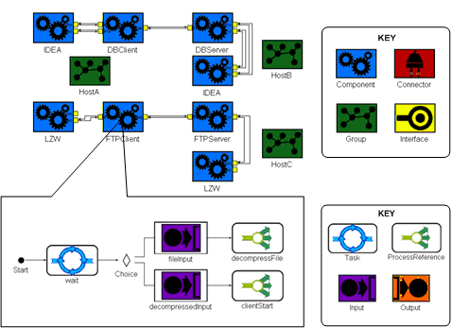
Example XTEAM Model
Software Architecture: Foundations, Theory, and Practice; Richard N. Taylor, Nenad Medvidovic, and Eric M. Dashofy; © 2008 John Wiley & Sons, Inc. Reprinted with permission.

Slide 26
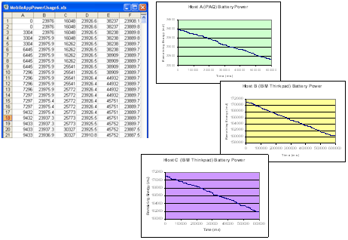
Example XTEAM Analysis
Software Architecture: Foundations, Theory, and Practice; Richard N. Taylor, Nenad Medvidovic, and Eric M. Dashofy; © 2008 John Wiley & Sons, Inc. Reprinted with permission.

Slide 27
XTEAM in a Nutshell
Goals | Consistency Compatibility Correctness
Scope | Component- and connector-level Subsystem- and system-level Data exchange
Concern | Structural Behavioral Interaction Non-functional
Models | Formal
Type | Dynamic Scenario-based
Automation Level | Automated
Stakeholders | Architects Developers Managers Customers Vendors
Software Architecture: Foundations, Theory, and Practice; Richard N. Taylor, Nenad Medvidovic, and Eric M. Dashofy; © 2008 John Wiley & Sons, Inc. Reprinted with permission.

Slide 28
Closing Remarks
Architectural analysis is neither easy nor cheap
The benefits typically far outweigh the drawbacks
Early information about the system’s key characteristics is indispensable
Multiple analysis techniques often should be used in concert
“How much analysis?”
  This is the key facet of an architect’s job
  Too many will expend resources unnecessarily
  Too few will carry the risk of propagating defects into the final system
  Wrong analyses will have both drawbacks

